Slide 1
Self-Service How To Guide
Table of Contents
-Get Started (Slides 2-4)
-Navigate the basics (slides 5-6)
-View and Accept your awards (slides 7-10)
-Find your cost of attendance/budget (slide 11)
-Contact Information (Slide 12)
HSC Student financial Aid

Slide 2
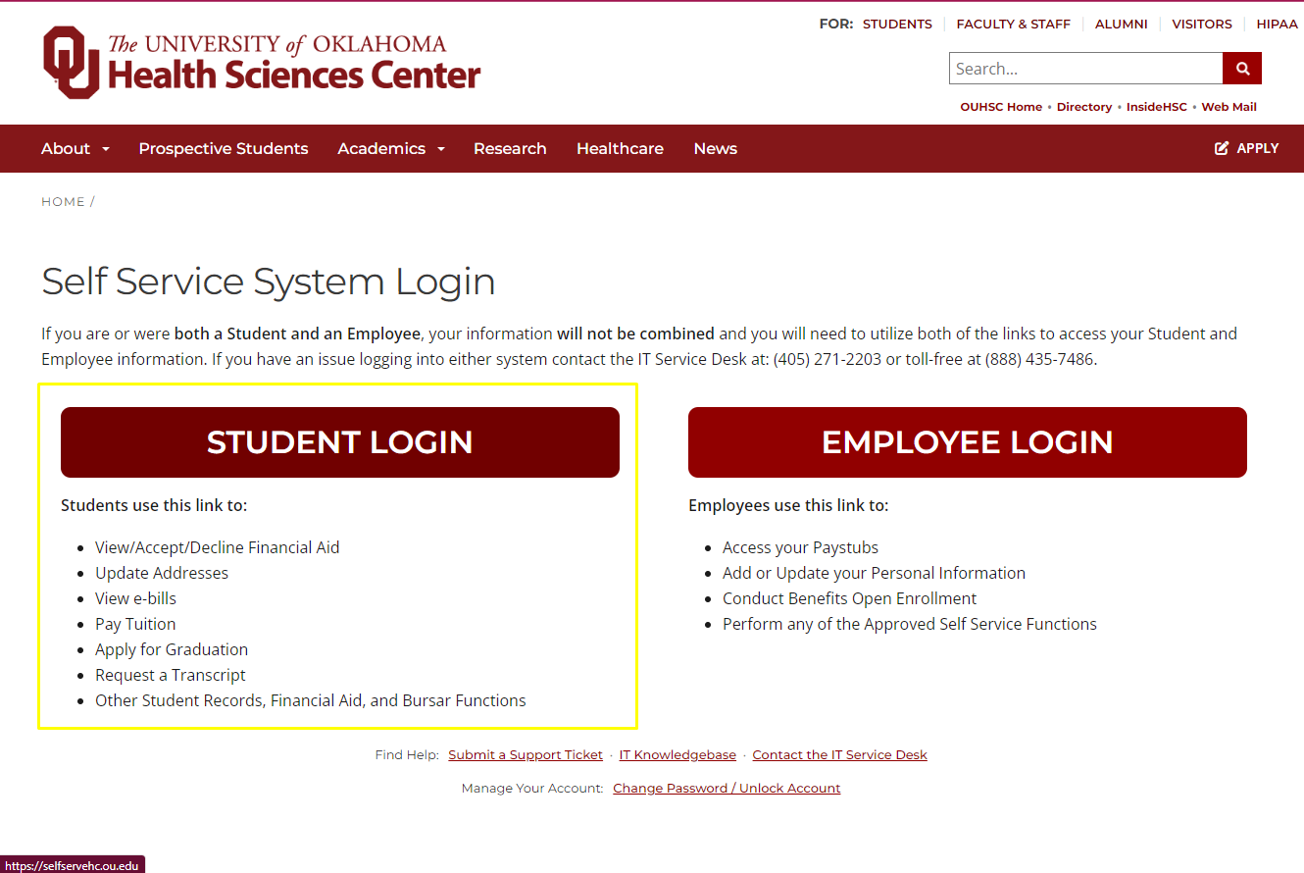
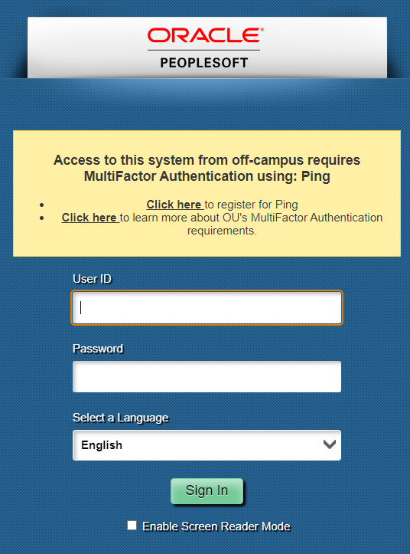
Self-service: getting started
Log into Self-Service directly at https://www.ouhsc.edu/selfserve
Use your OUHSC user name
And password to log in.
HSC Student financial aid

Slide 3
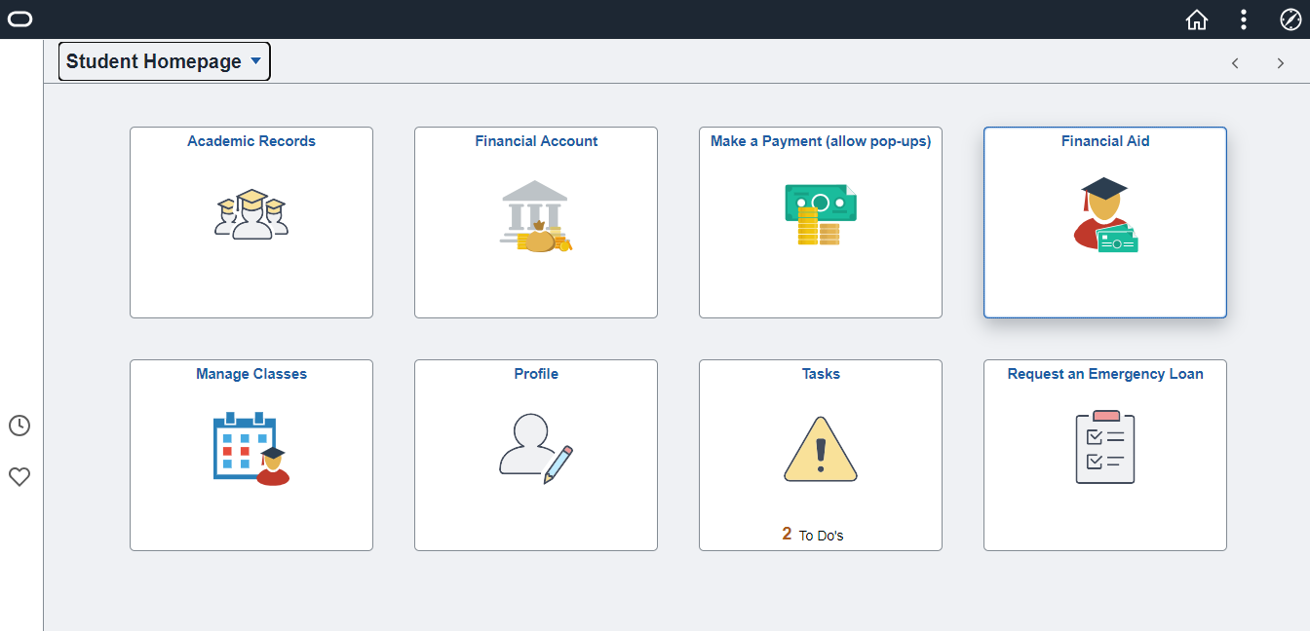
Self-service: getting started
Here you will see your primary self-service functions displayed as tiles.
-Academic Records: shows information pertaining to your course work, grades, transcripts, enrollment, and graduation
-Financial Account: This will display your current account balance.
-Make a Payment: This is effectively your Bursar account where you can make payments, authorize users, and more. *Please note your pop –up blocker must be turned off to use this feature.
-Financial Aid: Here you will find your awards for all years you’ve attended HSC
HSC Student financial aid

Slide 4
Self-service: getting started
Here you will see your primary self-service functions displayed as tiles.
-Manage Classes: Here you can view your classes and schedule
-Profile: Update your name, contact info, addresses, emergency contacts, and more
-Tasks: If any department in your college, Admissions and Records, the Bursar, or Financial Aid needs something from you, it will be listed here. Additionally any holds on your account will show in this tile
-Request an Emergency Loan: Here you may request an emergency loan from Financial Aid (conditions apply)
HSC Student financial aid

Slide 5
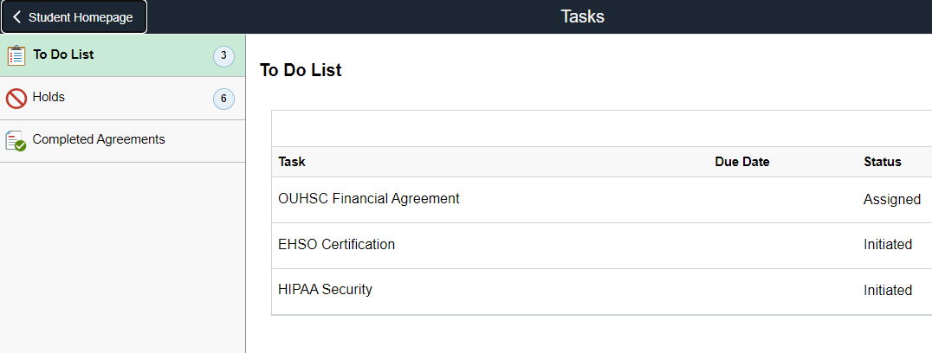
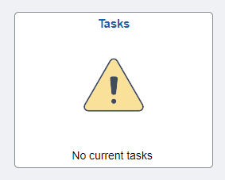
Self-Service: Navigate the Basics
Managing Tasks
When you click on the tasks tile, this is the screen that will populate. Your To Do list will be highlighted on the left with your tasks listed out on the right.
You can view any holds on your account by clicking on the Holds tab in the left menu, as well as any completed agreements.
Click the line item of your To Do list to obtain more information about what is needed.
If you have no tasks or holds, your Tasks tile on the main homepage will look like this:
HSC Student financial aid

Slide 6
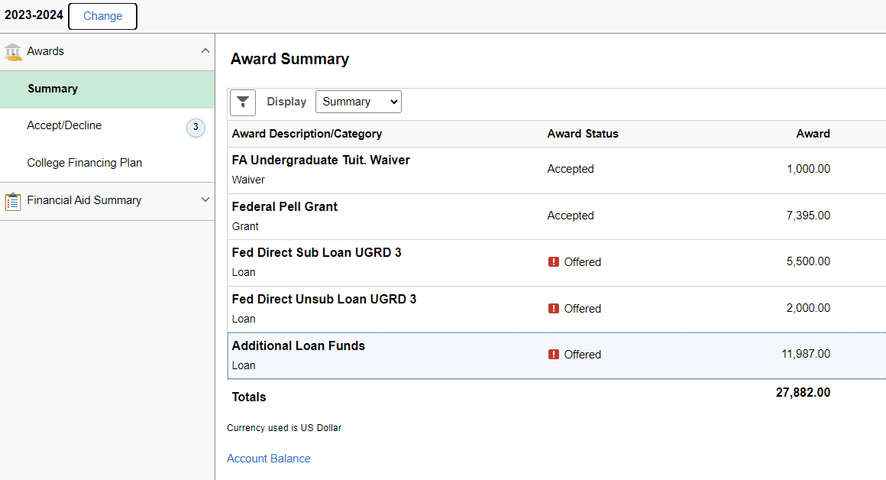
Self-Service: Navigate the Basics
Reviewing/Accepting/Making Changes to Financial Aid
Click on the Financial Aid tab on your home page to navigate to your Financial Aid awards screen.
Here you will find all loan offers and any additional waivers or scholarships that have been awarded to you. The award will be listed in bold with the type of award (waiver, grant, loan, etc.) listed underneath. The status (accepted, declined, or offered) will be listed next, and finally the amount of the award will be shown in the third column.
You can view more information about each award by clicking the link.
HSC Student financial aid

Slide 7
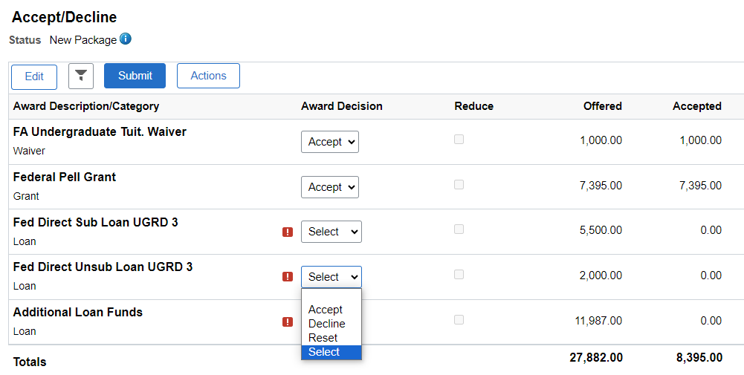
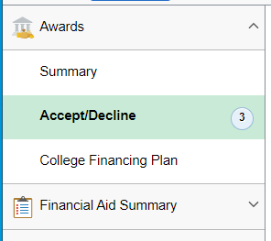
Accepting Financial Aid Awards
Once you are in your Financial Aid tile, you can click on Accept/Decline on the left menu bar, then click “Edit” above the list of your awards. This will open up new drop-down menus under “Award Decision” and you can select the option with which you wish to proceed.
All scholarships, waivers, and grants are automatically accepted on your behalf. Additional Loan Funds require a separate application with the lender of your choice (see slide 7).
Hsc student financial aid

Slide 8
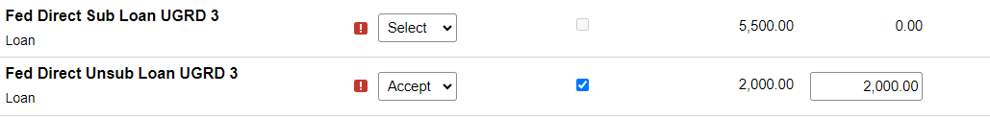
Accepting Financial Aid Awards
If you choose to accept an award, the checkbox under the Reduce column will be made available. You can click this, and it will then allow you to edit the amount you wish to borrow. Click Submit when done.
Please note that the amount you select is per aid year and will not be disbursed all at once. Depending on your enrollment, aid is disbursed in the following:
Summer/Fall/Spring
33% of the total loan amount for Summer
33% for Fall
34% for Spring
Total: 100%
Fall/Spring Only
50% of the total loan amount for Fall
50% for Spring
Total: 100%
*Totals listed above will vary based on student information and cost of attendance
Hsc student financial aid

Slide 9
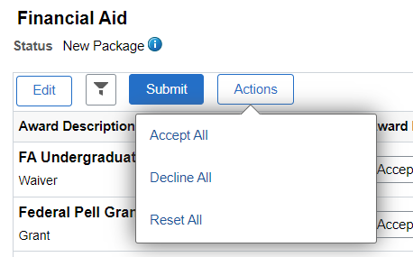
Accepting Financial Aid Awards
You may wish to accept or decline the full amount of all of the awards offered to you at once. If so, you can do this by clicking on “edit” and then “actions”. This will change the decision of all of the awards except the Additional Loan Funds (see more on the next slide).
If you choose to accept all, the reduce box will again be highlighted and you can change the accepted amount of aid on the right hand side of the screen. Click Submit at the top when you’ve made your selections.
Hsc student financial aid

Slide 10
Accepting Financial Aid Awards
Additional Loan Funds
These funds are not inherently tied to any specific loan type because students have the ability to choose what type of loan they would like to apply for from the following:
Graduate /Professional Students:
-Grad PLUS loan
-Alternative/Private Loan
Undergraduate Students:
-Parent PLUS loan (dependent students only)
-Alternative/Private Loan
Additionally, if you are awarded a scholarship, grant, or waiver at any time during the aid year, our office will adjust your Additional Loan Funds amount before altering the amount of any of your federal or private loans to accommodate for the funds coming from the new award.
HSC Student financial aid

Slide 11
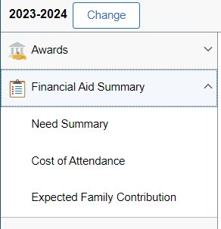
Self-Service: Need summary & Cost of Attendance
In the Financial Aid tile, You can view the current or previous aid years by clicking on “change” next to the current aid year listed.
By selecting the drop down arrow next to the Financial Aid Summary, you will be given an expanded menu that includes your calculated Need Summary, Cost of Attendance and Expected Family Contribution based on your FAFSA*.
*This option is likely to change in accordance with the changes to the FAFSA that will go into effect beginning with the 24-25 aid year.
HSC Student Financial Aid

Slide 12
Thank you!
If you have any questions regarding your financial aid, please contact us at financial-aid@ouhsc.edu or
405-271-2118.
If you are having issues with your self-service portal, you may need to contact information technology (IT) at https://it.ouhsc.edu/ or
405-271-2203
HSC student financial aid

